Slide 1
Introduction to Artificial Neural Networks

Slide 2
Contents
Introduction to Artificial Neural Networks
Biological Motivation
Neural Network Representation
Appropriate problems for Neural Network learning

Slide 3
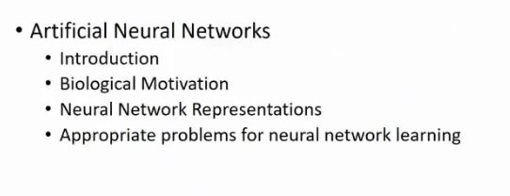

Slide 4
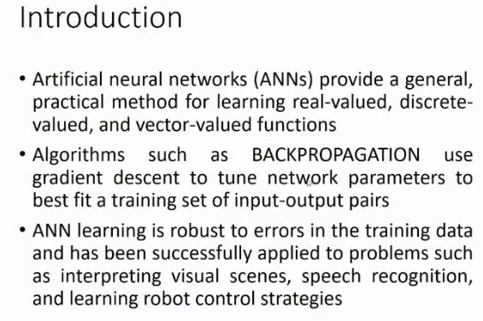

Slide 5
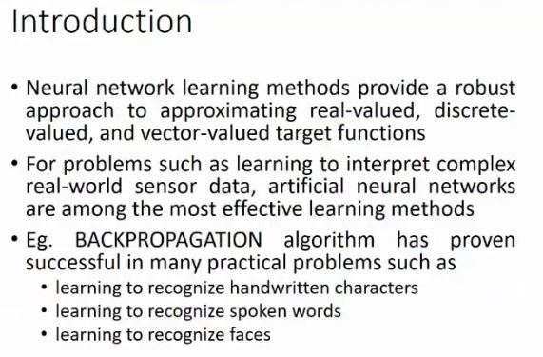

Slide 6
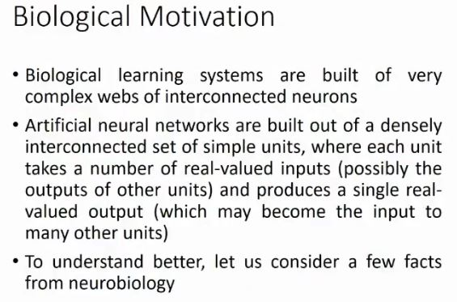

Slide 7
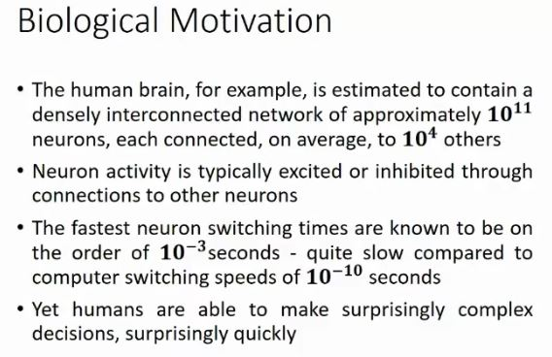

Slide 8
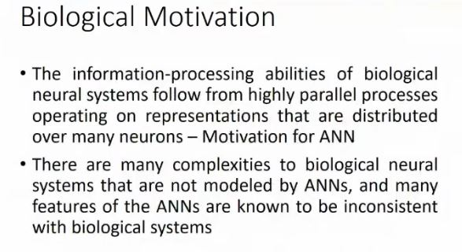

Slide 9
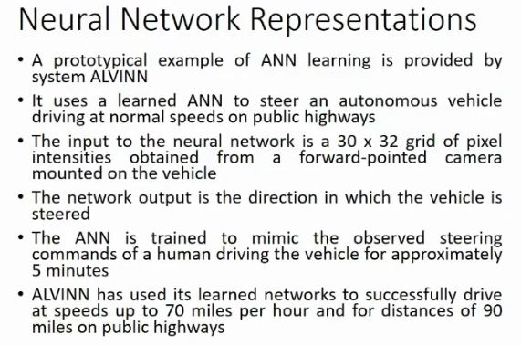

Slide 10
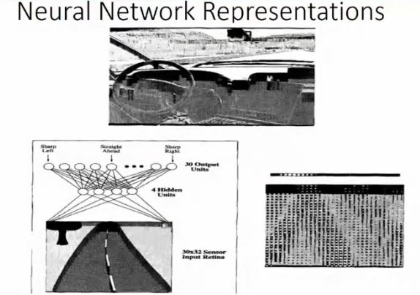

Slide 11
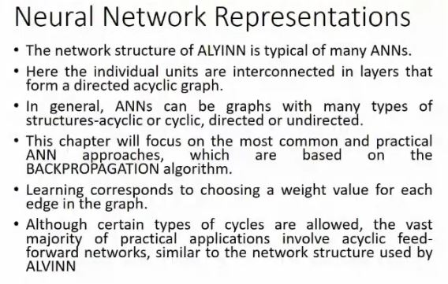

Slide 12
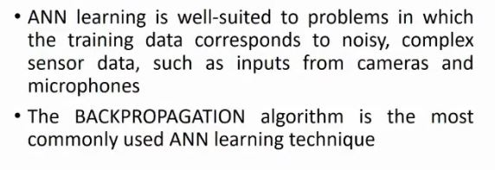
Appropriate problems for Neural Network learning

Slide 13
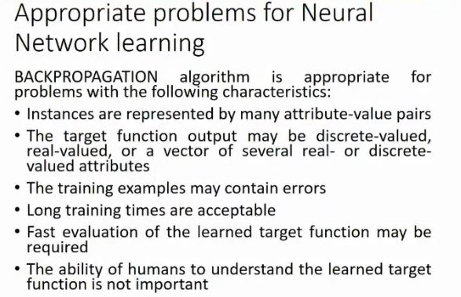

Slide 14
Thank
You

